Slide 1
CARDIOVASCULAR SYSTEM
ANATOMY AND PHYSIOLOGY

Slide 2
ANATOMY
The heart acts as two serial pumps that share several electrical and mechanical components.
The right heart circulates blood to the lungs where it is oxygenated, and the left heart receives this and circulates it to the rest of the body.
The atria are thin-walled structures that act as priming pumps for the ventricles, which provide most of the energy to the circulation.

Slide 3
Within the mediastinum, the atria are situated posteriorly and the left atrium (LA) sits anterior to the oesophagus and descending aorta.
The interatrial septum separates the two atria. In 20% of adults a patent foramen ovale is found; this communication in the fetal circulation between the right and left atria normally closes at birth .

Slide 4
The right atrium (RA) receives blood from the superior and inferior venae cavae and the coronary sinus. The LA receives blood from four pulmonary veins, two from each of the left and right lungs.
The ventricles are thick-walled structures, adapted to circulating blood through large vascular beds under pressure.

Slide 5
The atria and ventricles are separated by the annulus fibrosus, which forms the skeleton for the atrioventricular (AV) valves and which electrically insulates the atria from the ventricles.
The right ventricle (RV) is roughly triangular in shape and extends from the annulus fibrosus to near the cardiac apex, which is situated to the left of the midline.

Slide 6
Its anterosuperior surface is rounded and convex, and its posterior extent is bounded by the interventricular septum, which bulges into the chamber.
Its upper extent is conical, forming the conus arteriosus or outflow tract, from which the pulmonary artery arises.

Slide 7
The RV sits anterior to and to the right of the left ventricle (LV).
The LV is more conical in shape and in cross-section is nearly circular. It extends from the LA to the apex of the heart.
The LV myocardium is normally around 10mm thick (c.f. RV thickness of 2–3mm) because it pumps blood at a higher pressure.

Slide 8
The normal heart occupies less than 50% of the transthoracic diameter in the frontal plane, as seen on a chest X-ray.
On the patient’s left, the cardiac silhouette is formed by the aortic arch, the pulmonary trunk, the left atrial appendage and the LV.

Slide 9
On the right, the RA is joined by superior and inferior venae cavae, and the lower right border is made up by the RV .
In disease states or congenital cardiac abnormalities, the silhouette may change as a result of hypertrophy or dilatation.

Slide 10
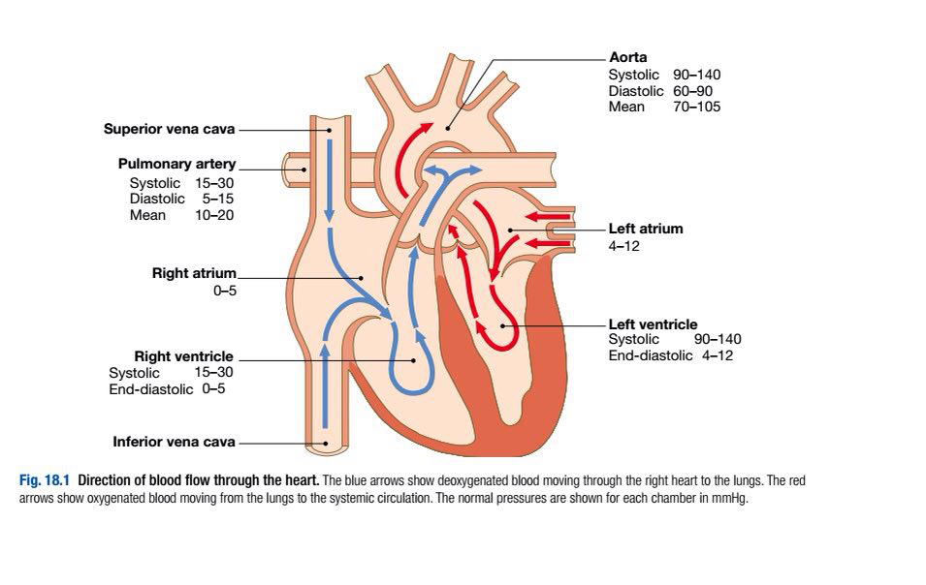

Slide 11
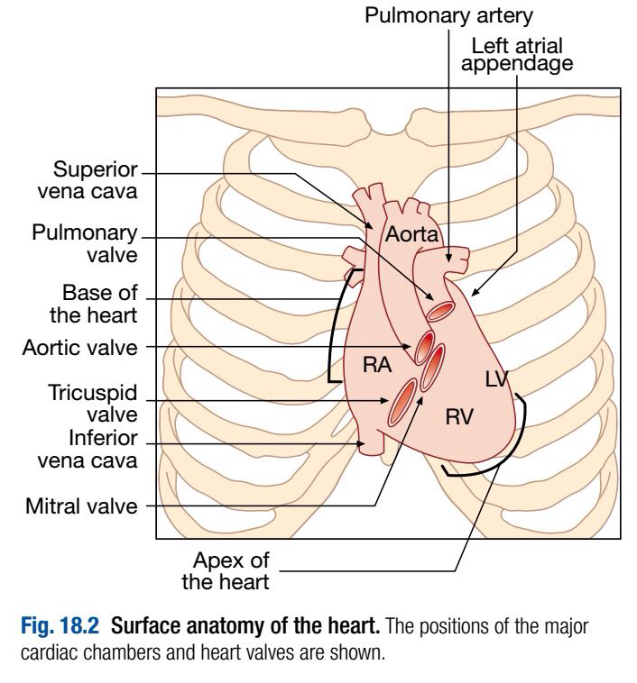

Slide 12
CORONARY CIRCULATION
The left main and right coronary arteries arise from the left and right coronary sinuses of the aortic root, distal to the aortic valve.
Within 2.5cm of its origin, the left main coronary artery divides into the left anterior descending artery (LAD), which runs in the anterior interventricular groove, and the left circumflex artery (CX), which runs posteriorly in the atrioventricular groove.

Slide 13
The LAD gives branches to supply the anterior part of the septum (septal perforators) and the anterior, lateral and apical walls of the LV.
The CX gives marginal branches that supply the lateral, posterior and inferior segments of the LV.

Slide 14
The right coronary artery (RCA) runs in the right atrioventricular groove, giving branches that supply the RA, RV and inferoposterior aspects of the LV.

Slide 15
The posterior descending artery runs in the posterior interventricular groove and supplies the inferior part of the interventricular septum.
This vessel is a branch of the RCA in approximately 90% of people (dominant right system) and is supplied by the CX in the remainder (dominant left system).

Slide 16
The coronary anatomy varies greatly from person to person and there are many ‘normal variants’.
The RCA supplies the sinoatrial (SA) node in about 60% of individuals and the AV node in about 90%.
Proximal occlusion of the RCA therefore often results in sinus bradycardia and may also cause AV nodal block.

Slide 17
Abrupt occlusions in the RCA, due to coronary thrombosis, result in infarction of the inferior part of the LV and often the RV.
Abrupt occlusion of the LAD or CX causes infarction in the corresponding territory of the LV, and occlusion of the left main coronary artery is usually fatal.

Slide 18
The venous system follows the coronary arteries but drains into the coronary sinus in the atrioventricular groove, and then to the RA.
An extensive lymphatic system drains into vessels that travel with the coronary vessels and then into the thoracic duct.

Slide 19
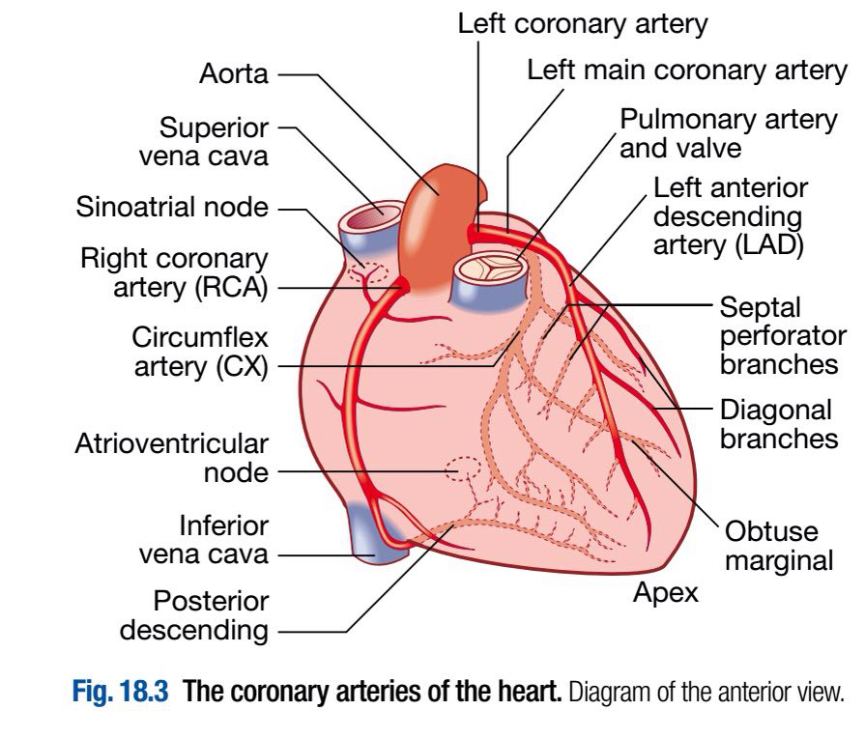

Slide 20
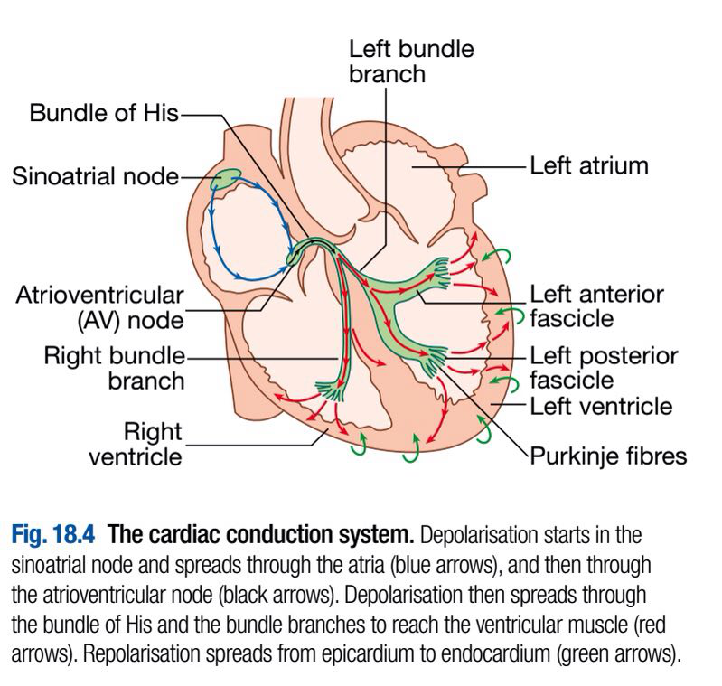
CONDUCTING SYSTEM OF THE HEART

Slide 21
The SA node is situated at the junction of the superior vena cava and RA . It comprises specialised atrial cells that depolarise at a rate influenced by the autonomic nervous system and by circulating catecholamines.

Slide 22
During normal (sinus) rhythm, this depolarisation wave propagates through both atria via sheets of atrial myocytes.
The annulus fibrosus forms a conduction barrier between atria and ventricles, and the only pathway through it is the AV node.
This is a midline structure, extending from the right side of the interatrial septum, penetrating the annulus fibrosus anteriorly.

Slide 23
The AV node conducts relatively slowly, producing a necessary time delay between atrial and ventricular contraction.
The His–Purkinje system is comprised of the bundle of His extending from the AV node into the interventricular septum, the right and left bundle branches passing along the ventricular septum and into the respective ventricles, the anterior and posterior fascicles of the left bundle branch, and the smaller Purkinje fibres that ramify through the ventricular myocardium.

Slide 24
The tissues of the His–Purkinje system conduct very rapidly and allow near-simultaneous depolarisation of the entire ventricular myocardium.

Slide 25
NERVE SUPPLY OF THE HEART
The heart is innervated by both sympathetic and parasympathetic fibres.
Adrenergic nerves from the cervical sympathetic chain supply muscle fibres in the atria and ventricles and the electrical conducting system.

Slide 26
Positive inotropic and chronotropic effects are mediated by β1-adrenoceptors, whereas β2-adrenoceptors predominate in vascular smooth muscle and mediate vasodilatation.

Slide 27
Parasympathetic pre-ganglionic fibres and sensory fibres reach the heart through the vagus nerves.
Cholinergic nerves supply the AV and SA nodes via muscarinic (M2) receptors.
Under resting conditions, vagal inhibitory activity predominates and the heart rate is slow.

Slide 28
Adrenergic stimulation associated with exercise, emotional stress, fever and so on causes the heart rate to increase. In disease states the nerve supply to the heart may be affected. For example, in heart failure the sympathetic system may be up-regulated, and in diabetes mellitus the nerves themselves may be damaged (autonomic neuropathy) so that there is little variation in heart rate.

Slide 29
PHYSIOLOGY
THE CIRCULATION
The RA receives deoxygenated blood from the superior and inferior venae cavae and discharges blood to the RV, which in turn pumps it into the pulmonary artery.
Blood passes through the pulmonary arterial and alveolar capillary bed where it is oxygenated, then drains via four pulmonary veins into the LA.

Slide 30
This in turn fills the LV, which delivers blood into the aorta.
During ventricular contraction (systole), the tricuspid valve in the right heart and the mitral valve in the left heart close, and the pulmonary and aortic valves open.

Slide 31
In diastole, the pulmonary and aortic valves close, and the two AV valves open. Collectively, these atrial and ventricular events constitute the cardiac cycle of filling and ejection of blood from one heartbeat to the next.

Slide 32
MYOCARDIAL CONTRACTION
Myocardial cells (myocytes) are about 50–100 μm long; each cell branches and interdigitates with adjacent cells.
An intercalated disc permits electrical conduction via gap junctions, and mechanical conduction via the fascia adherens, to adjacent cells.

Slide 33
The basic unit of contraction is the sarcomere (2 μm long), which is aligned to those of adjacent myofibrils, giving a striated appearance due to the Z-lines. Actin filaments are attached at right angles to the Z-lines and interdigitate with thicker parallel myosin filaments.

Slide 34
The cross links between actin and myosin molecules contain myofibrillar ATPase, which breaks down adenosine triphosphate (ATP) to provide the energy for contraction.

Slide 35
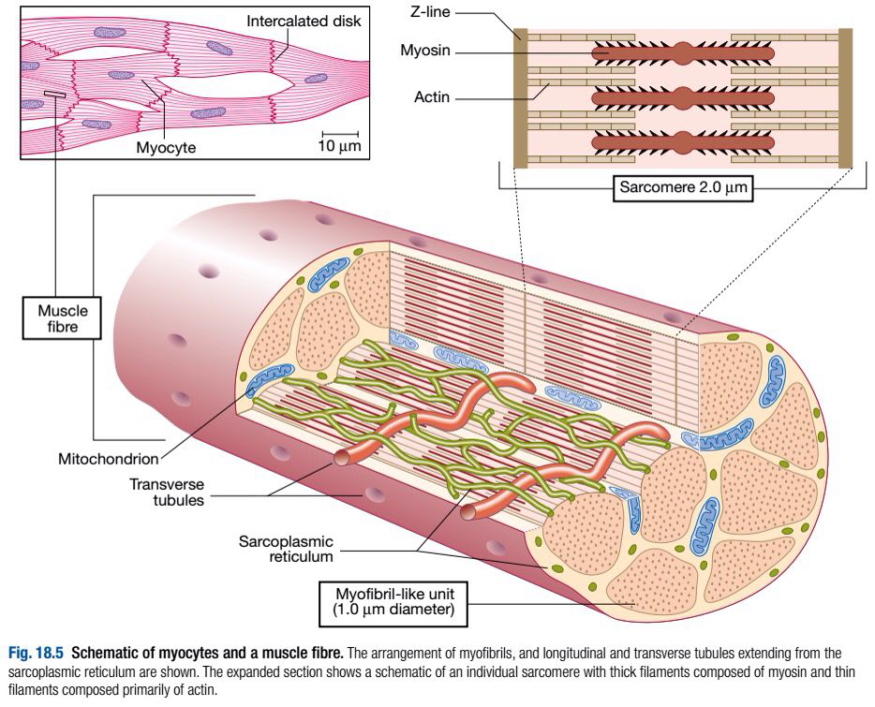

Slide 36
Two chains of actin molecules form a helical structure, with a second molecule, tropomyosin, in the grooves of the actin helix, and a further molecule complex, troponin, attached to every seventh actin molecule.
During the plateau phase of the action potential, calcium ions enter the cell and are mobilised from the sarcoplasmic reticulum.

Slide 37
They bind to troponin and thereby precipitate contraction by shortening of the sarcomere through the interdigitation of the actin and myosin molecules.
The force of cardiac muscle contraction, or inotropic state, is regulated by the influx of calcium ions through ‘slow calcium channels’.

Slide 38
The extent to which the sarcomere can shorten determines stroke volume of the ventricle.
It is maximally shortened in response to powerful inotropic drugs or marked exercise.
However, the enlargement of the heart seen in heart failure is due to slippage of the myofibrils and adjacent cells rather than lengthening of the sarcomere.

Slide 39
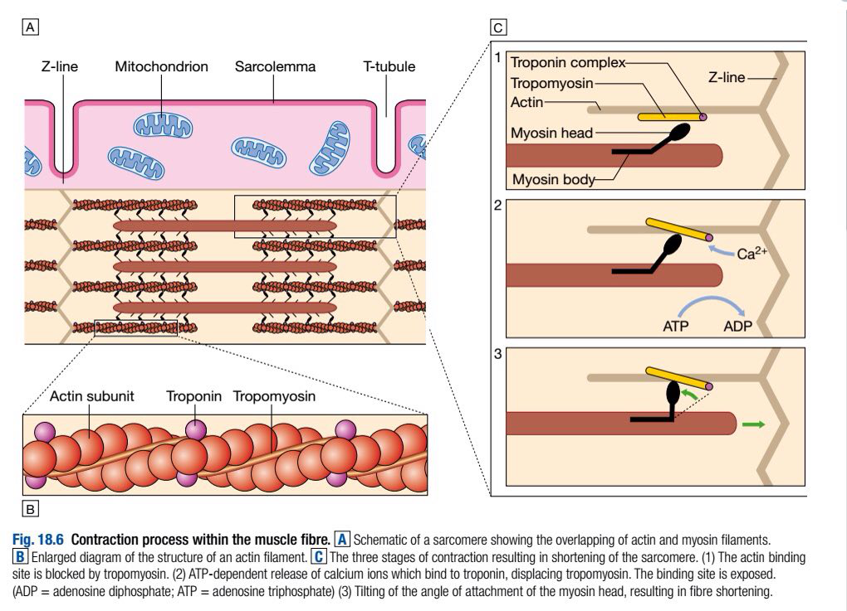

Slide 40
CARDIAC OUTPUT
Cardiac output is the product of stroke volume and heart rate.
Stroke volume is the volume of blood ejected in each cardiac cycle, and is dependent upon end-diastolic volume and pressure (preload), myocardial contractility and systolic aortic pressure (afterload).

Slide 41
Stretch of cardiac muscle (from increased end-diastolic volume) causes an increase in the force of contraction, producing a greater stroke volume: Starling’s Law of the heart.
The contractile state of the myocardium is controlled by neuro-endocrine factors, such as adrenaline (epinephrine), and can be influenced by inotropic drugs and their antagonists.

Slide 42
The response to a physiological change or to a drug can be predicted on the basis of its combined influence on preload, afterload and contractility.

Slide 43
BLOOD FLOW
Blood passes from the heart through the large central elastic arteries into muscular arteries before encountering the resistance vessels, and ultimately the capillary bed where there is exchange of nutrients, oxygen and waste products of metabolism.

Slide 44
The central arteries, such as the aorta, are predominantly composed of elastic tissue with little or no vascular smooth muscle cells.
When blood is ejected from the heart, the compliant aorta expands to accommodate the volume of blood before the elastic recoil sustains blood pressure (BP) and flow following cessation of cardiac contraction.

Slide 45
This ‘Windkessel effect’ prevents excessive rises in systolic BP whilst sustaining diastolic BP, thereby reducing cardiac afterload and maintaining coronary perfusion. These benefits are lost with progressive arterial stiffening: a feature of ageing and advanced renal disease.

Slide 46
Passing down the arterial tree, vascular smooth muscle cells progressively play a greater role until the resistance arterioles are encountered.
Although all vessels contribute, the resistance vessels (diameter 50–200 μm) provide the greatest contribution to systemic vascular resistance, with small changes in radius having a marked influence on blood flow; resistance is proportional to the fourth power of the radius (Poiseuille’s Law).

Slide 47
The tone of these resistance vessels is tightly regulated by humoral, neuronal and mechanical factors.
Neurogenic constriction operates via α-adrenoceptors on vascular smooth muscle, and dilatation via muscarinic and β2-adrenoceptors.

Slide 48
In addition, systemic and locally released vasoactive substances influence tone; vasoconstrictors include noradrenaline (norepinephrine), angiotensin II and endothelin-1, whereas adenosine, bradykinin, prostaglandins and nitric oxide are vasodilators.
Resistance to blood flow rises with viscosity and is mainly influenced by red cell concentration (haematocrit).

Slide 49
Coronary blood vessels receive sympathetic and parasympathetic innervation.
Stimulation of α-adrenoceptors causes vasoconstriction; stimulation of β2-adrenoceptors causes vasodilatation; the predominant effect of sympathetic stimulation in coronary arteries is vasodilatation.

Slide 50
Parasympathetic stimulation also causes modest dilatation of normal coronary arteries.
As a result of vascular regulation, an atheromatous narrowing (stenosis) in a coronary artery does not limit flow, even during exercise, until the cross-sectional area of the vessel is reduced by at least 70%.

Slide 51
ENDOTHELIAL FUNCTION
The endothelium plays a vital role in the control of vascular homeostasis.
It synthesises and releases many vasoactive mediators that cause vasodilatation, including nitric oxide, prostacyclin and endothelium-derived hyperpolarising factor, and vasoconstriction, including endothelin-1 and angiotensin II.

Slide 52
A balance exists whereby the release of such factors contributes to the maintenance and regulation of vascular tone and BP.
Damage to the endothelium may disrupt this balance and lead to vascular dysfunction, tissue ischaemia and hypertension.

Slide 53
The endothelium also has a major influence on key regulatory steps in the recruitment of inflammatory cells and on the formation and dissolution of thrombus.
Once activated, the endothelium expresses surface receptors such as E-selectin, intercellular adhesion molecule type 1 (ICAM-1) and platelet endothelial cell adhesion molecule type 1 (PECAM-1), which mediate rolling, adhesion and migration of inflammatory leucocytes into the subintima.

Slide 54
The endothelium also stores and releases the multimeric glycoprotein, von Willebrand factor, which promotes thrombus formation by linking platelet adhesion to denuded surfaces, especially in the arterial vasculature.
In contrast, once intravascular thrombus forms, tissue plasminogen activator is rapidly released from a dynamic storage pool within the endothelium to induce fibrinolysis and thrombus dissolution.

Slide 55
These processes are critically involved in the development and progression of atherosclerosis, and endothelial function and injury is seen as central to the pathogenesis of many cardiovascular disease states.

Slide 56
EFFECTS OF RESPIRATION
There is a fall in intrathoracic pressure during inspiration that tends to promote venous flow into the chest, producing an increase in the flow of blood through the right heart.
However, a substantial volume of blood is sequestered in the chest as the lungs expand; the increase in the capacitance of the pulmonary vascular bed usually exceeds any increase in the output of the right heart and there is therefore a reduction in the flow of blood into the left heart during inspiration.

Slide 57
In contrast, expiration is accompanied by a fall in venous return to the right heart, a reduction in the output of the right heart, a rise in the venous return to the left heart (as blood is squeezed out of the lungs) and an increase in the output of the left heart.

Slide 58
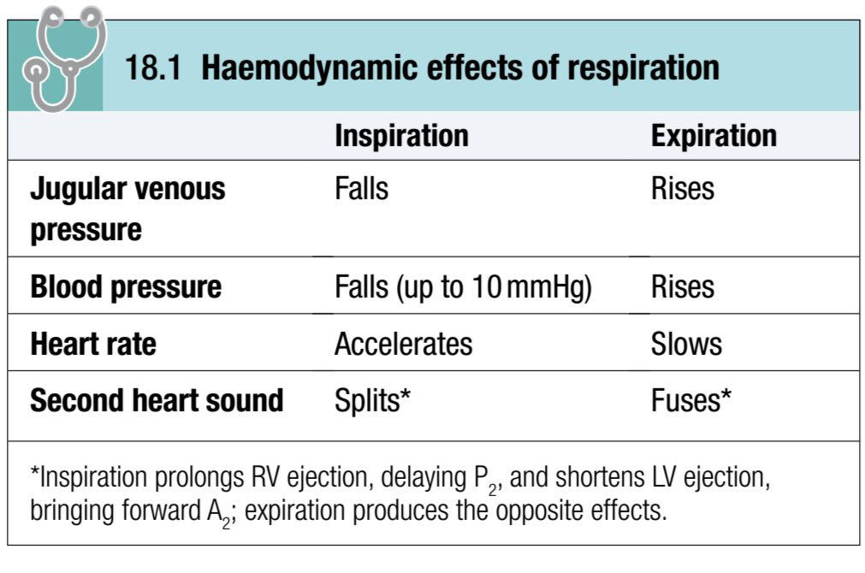

Slide 59
PULSUS PARADOXUS
This term is used to describe the exaggerated fall in BP during inspiration that is characteristic of cardiac tamponade and severe airways obstruction.
In airways obstruction, it is due to accentuation of the change in intrathoracic pressure with respiration.

Slide 60
In cardiac tamponade, compression of the right heart prevents the normal increase in flow through the right heart on inspiration, which exaggerates the usual drop in venous return to the left heart and produces a marked fall in BP.

